Slide 1
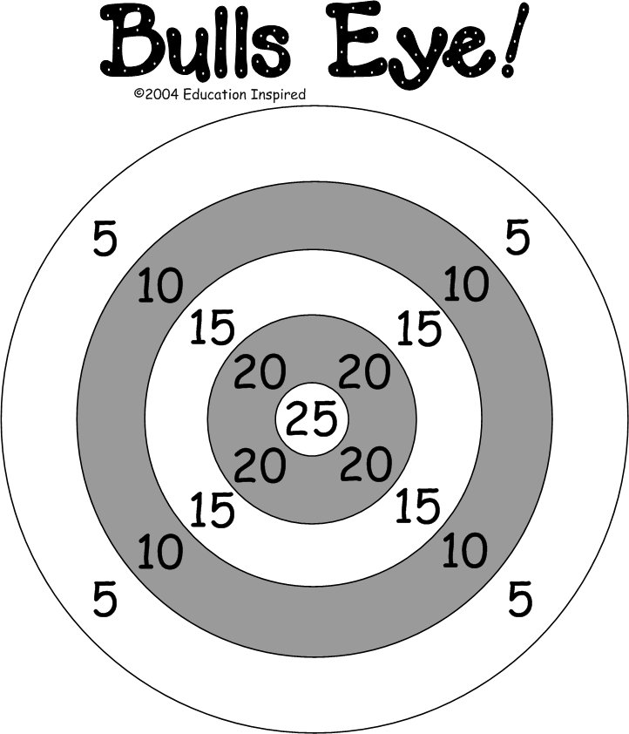
Notes:
Display the target on a white board. When a child (or group) responds correctly the child (or one person from the group) throws a suction ball at the target. The child (or group) earns the number of points in the section where the ball sticks. If the ball does not stick, no points are awarded.

